Slide 1
Dart Part 3
DMIT 2504 Week 1 day 3

Slide 2





Announcements

Slide 3
Expectations
No Late Assignments
No Cheating
Be a good classmate
Don’t go to stupid sites in class
Show up to class

Slide 4
Async Code
Code that takes a long time to execute should not freeze our program
If we run it synchronously it freezes our program
Running it asynchronously allows the rest of the program to execute while we wait
async – keyword used to designate a
function as asynchronous
await – keyword used to tell the program
to wait on an async function

Slide 5
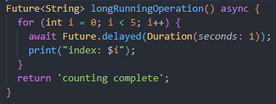
Futures
Used for the return type of async functions
Represents a value that will exist in the future
Future<Type>

Slide 6
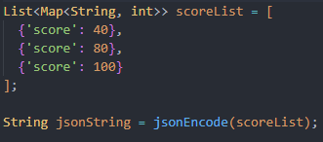

JSON
JavaScript Object Notation
Very common standard for passing information around on the internet
‘dart:convert’ package

Slide 7
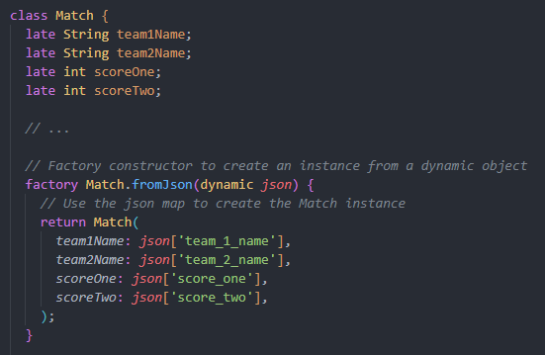
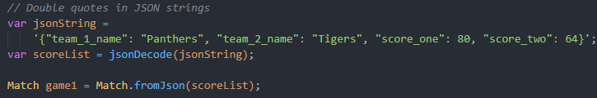
Parsing JSON
jsonDecode returns a dynamic
It is much more stable to encode the data as a class
Use a Factory constructor

Slide 8

Web Requests
Notes:
Endpoint is a string
Are async

